Slide 1
Run-in- aged mice
UTH, Houston

Slide 2
60 min MCAo
CCA/ICA open
Filament as in phase 2 but with longer 4-5 mm coating

Slide 3
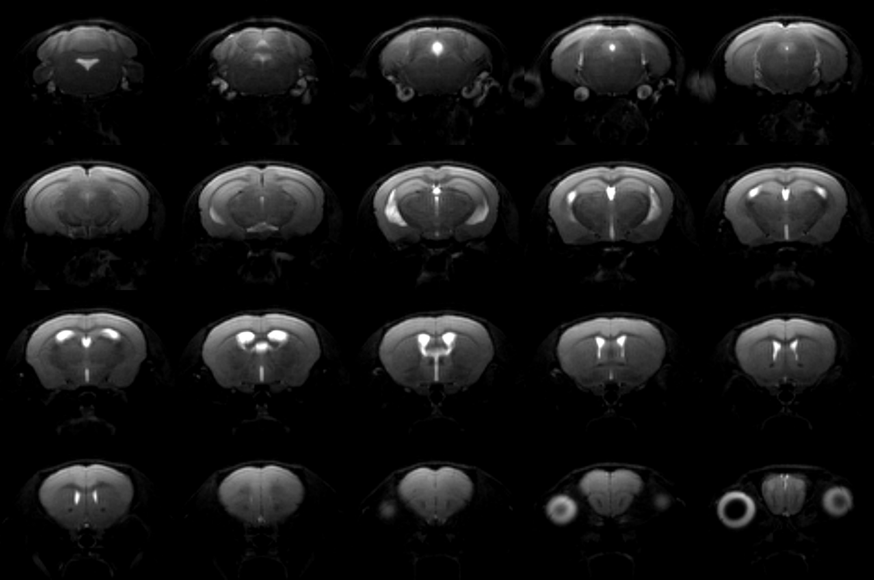
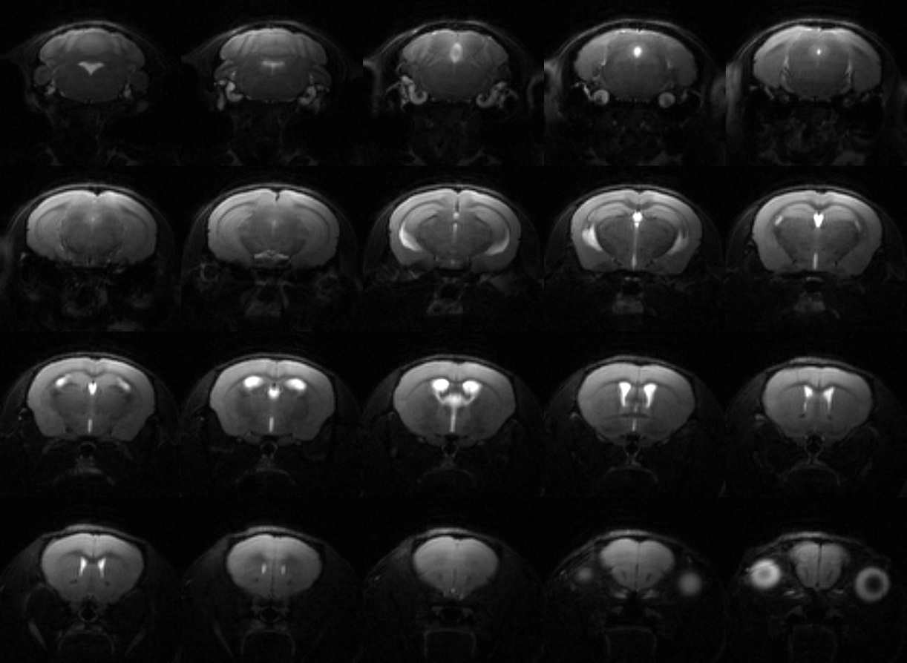
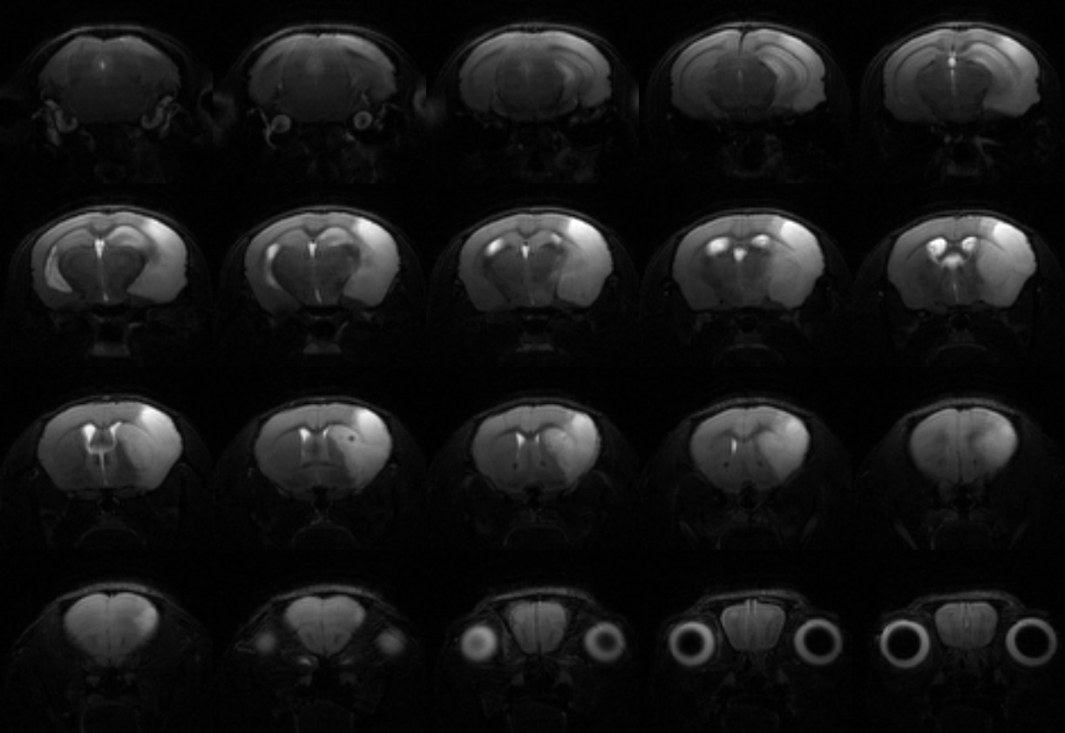
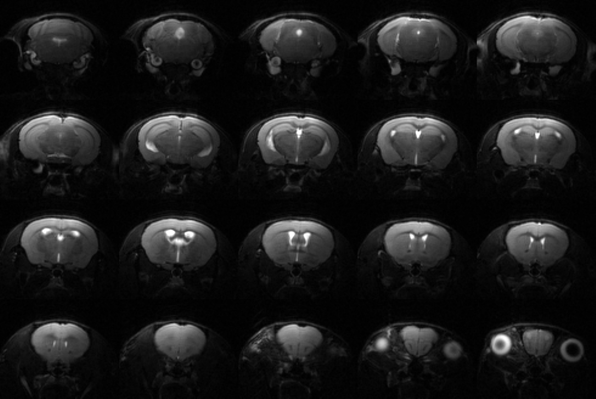
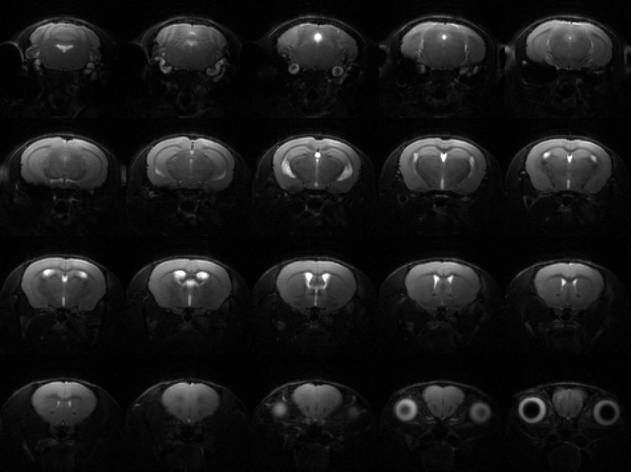
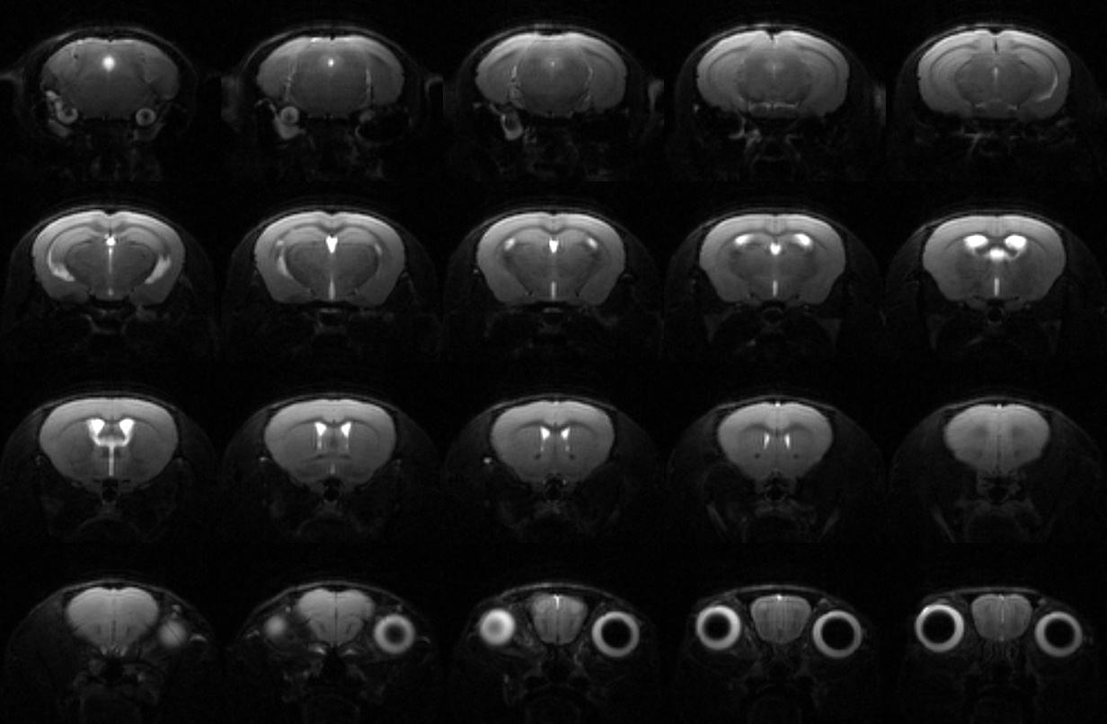
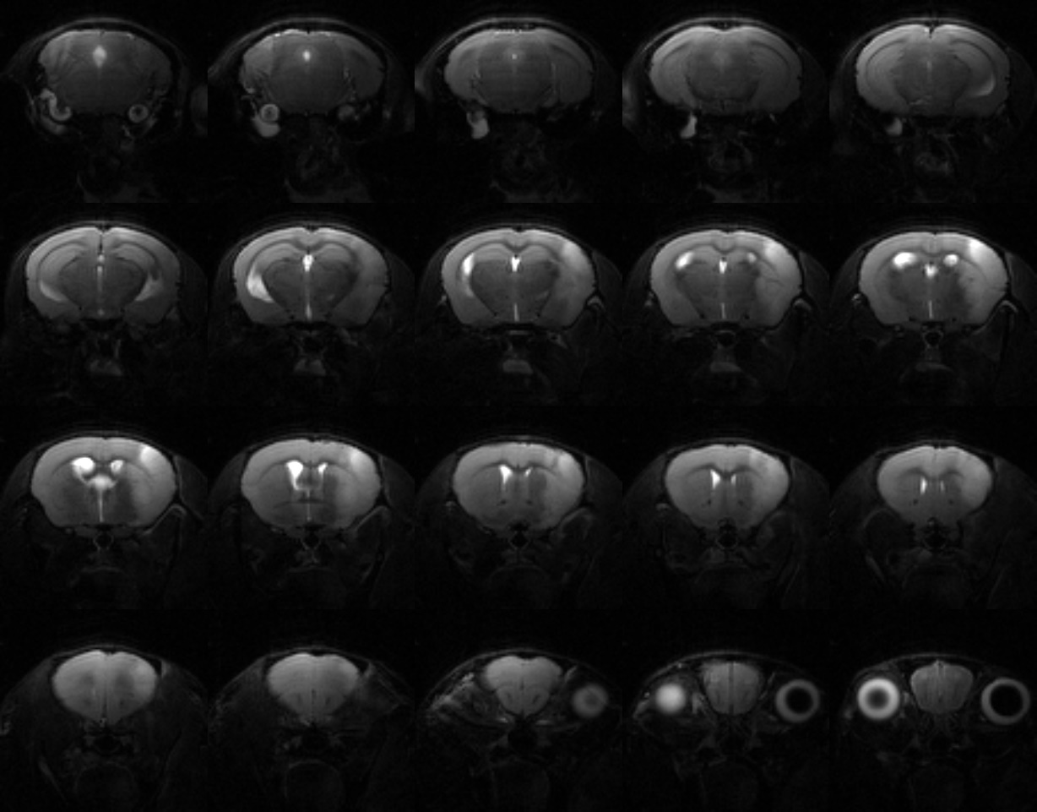
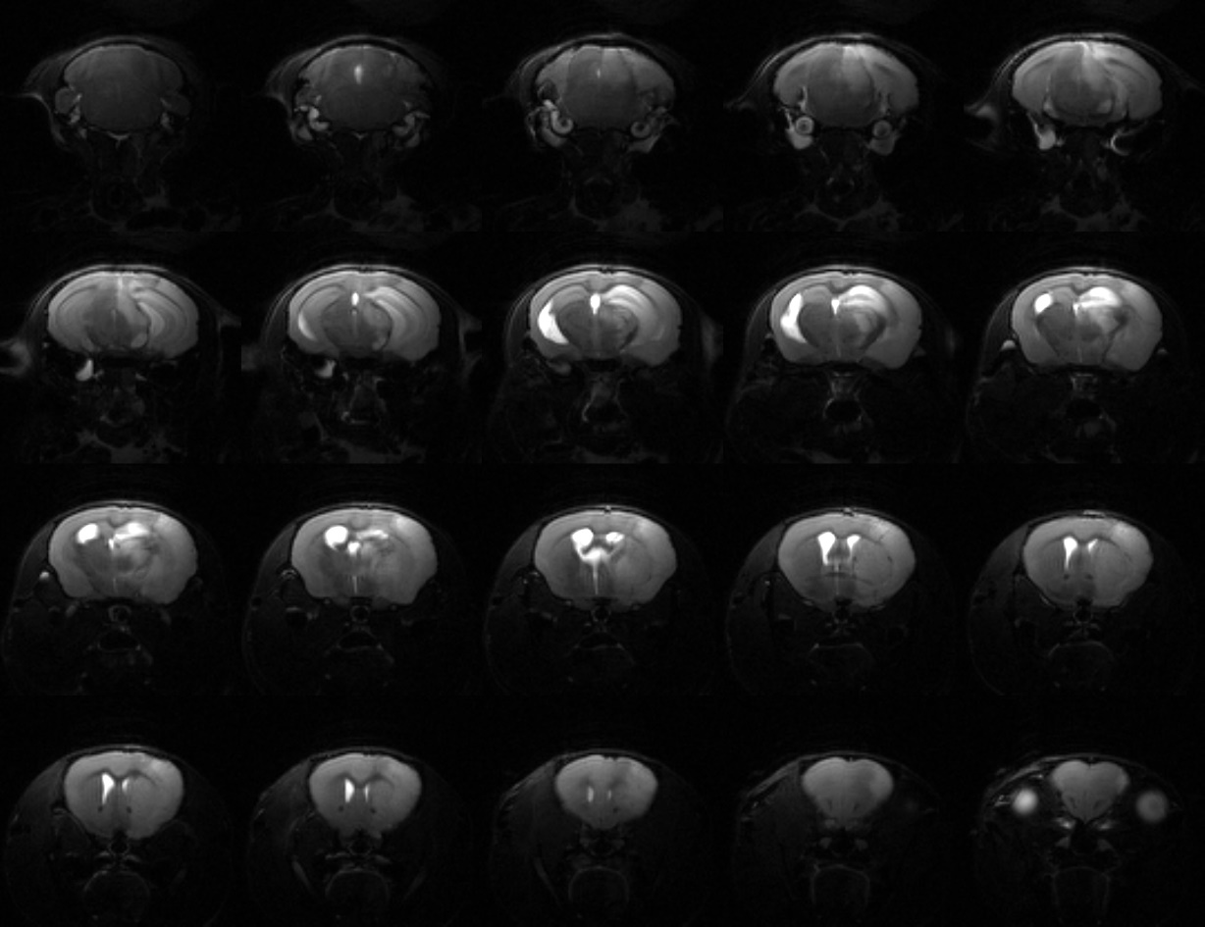
1A
2A
3A
1B
2B
3B
4B
5B

Slide 4
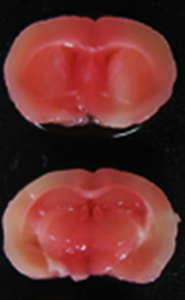
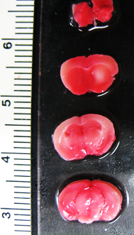
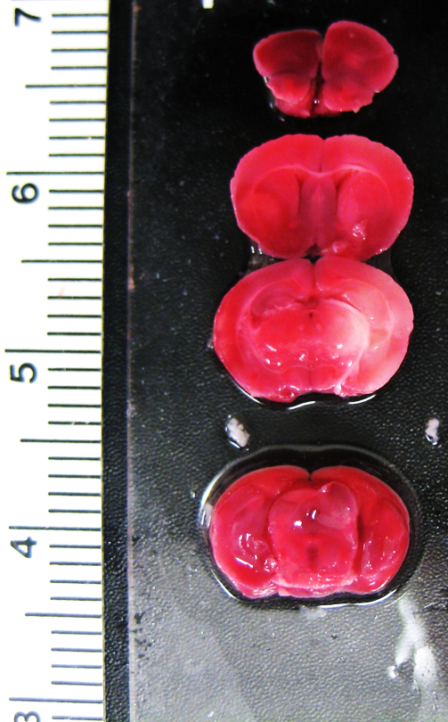
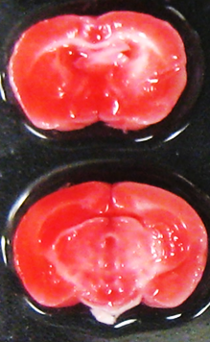
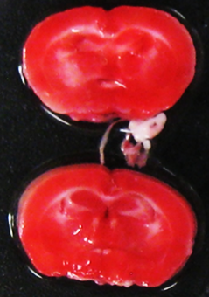
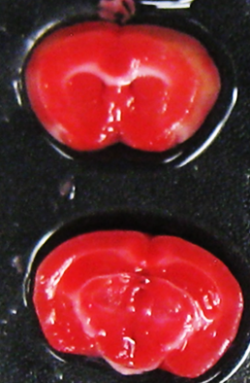
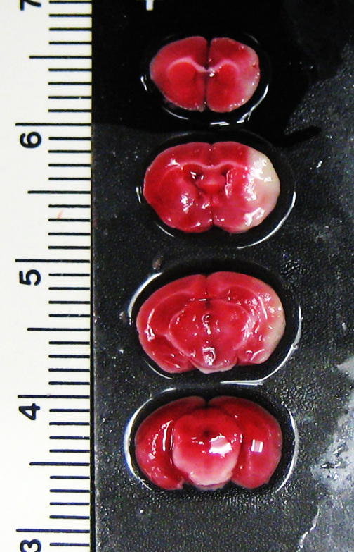
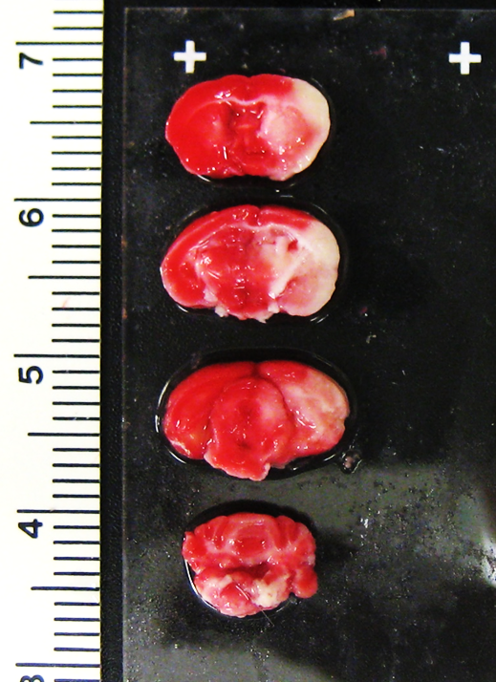
1A
2A
3A
1B
2B
3B
4B
5B
3A
4B
5B

Slide 5
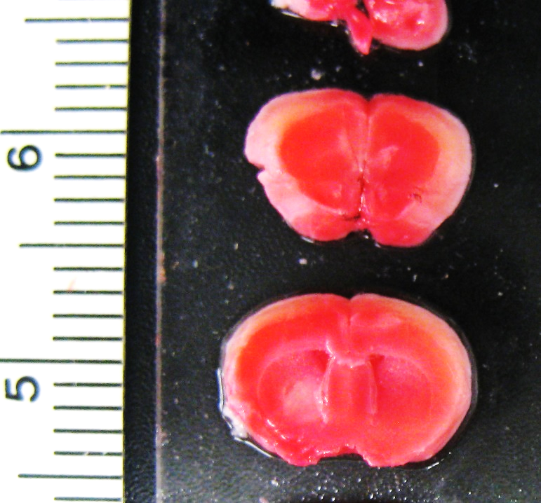
2A

Slide 6

Right MCAo; 48h after stroke
Animal ID | NDS | Corner test score (L/R) | Infarcts | Comments
1A | 3 | Not performed | No | White mark (whitener) -7-8 mm (6023)
2A | 2 | No pre; post-2/8 | Yes | White mark (whitener) -7-8 mm
3A | 0 | No pre, post - 6/4 | Yes/CTX | White mark (whitener) -7-8 mm
1B | 0 | Pre-5/5; post-7/3 | No | White mark (whitener) -7-8 mm
2B | 0 | Pre-5/5; post-8/2 | No | White mark (whitener) -9-10 mm (not fully advanced)
3B | 0 | Pre-5/5; post-10/0 | No | White mark (whitener) -9-10 mm
4B | 2 | Pre-5/5; post-4/6 | Yes/CTX | White mark (whitener) -9-10 mm
5B | 4 | Pre-4/6; dead | Yes/CTX | White mark (whitener) -9-10 mm
Recommendation- Laser Doppler for monofilament placement

